Slide 1





Advanced exergy analysis and optimization of a CO2 to methanol process
based on rigorous modeling and simulation
Presented by Arian Wazed

Slide 2
OVERVIEW
Major Challenge in the 21st Century:
Controlling greenhouse gas emissions is a significant challenge.
CO2 has risen by 30% due to fossil fuel consumption, leading to environmental issues.
Global Importance of Carbon Reduction:
Carbon reduction is crucial on a global scale.
Challenges with Carbon Capture and Storage (CCS):
CCS is suggested, but challenges persist in its implementation.
Focus of the Study:
The study centers on the catalytic hydrogenation of CO2 to methanol.
Exploration through Advanced Exergy Analysis:
The process's thermodynamic performance is explored using advanced exergy analysis.
This analysis aims to identify effective improvement measures and enable parametric optimization.
Main Contributions of the Study:
Material and energy flow modeling is conducted.
Conventional and advanced exergy analyses are performed.
Effective improvement measures for the CO2 to methanol process are identified.

Slide 3

INTRODUCTION
This presentation examines the importance of efficiently converting CO2 to achieve carbon neutrality goals, focusing on producing green methanol and green hydrogen using captured CO2 and renewable energy sources. An advanced exergy analysis of the CO2 to methanol (CTM) process demonstrates a significant potential for improvement (46.55%) by reducing exergy destruction, with a particular focus on addressing endogenous exergy destruction. Proposed strategies aim to reduce avoidable exergy destruction, potentially leading to a 14.78% reduction in total exergy destruction and a 4.91% increase in exergy efficiency. This research emphasizes the potential for significant carbon emissions reduction and offers promising strategies for enhancing the efficiency of CO2 conversion processes.

Slide 4
Process description
CTM Process Overview:
Reaction-separation-recycle process illustrated in Fig. 1.
Raw Materials:
Carbon dioxide from industrial flue gas.
Hydrogen generated by water electrolysis from renewable energy sources.
Process Conditions:
Mixture of CO2 and H2 gases pressurized and heated to 5–10 MPa and 200–300 ℃.
Methanol Synthesis Reactor:
CO2 reacts with H2 to produce methanol (Eq. (1)).
Two parallel reactions also occur (Eqs. (2) and (3)).
Process uses 0.41 MPa saturated deoxygenated water to manage reactor heat.
Output of Reactor:
Contains products (CH3OH and H2O) and unreacted raw gases (H2, CO2, and CO) due to chemical equilibrium.
Gas-Liquid Flash:
Employed to separate unreacted gas from methanol.
Most output gas recycled to methanol synthesis reactor to increase conversion.
Remaining gas serves as tail gas to avoid high inert gas content.
Liquid Stream Processing:
Sent to a separation column to remove light gas from methanol.
Distillation column used to obtain high-purity methanol product.
Equations:
CO2 + 3H2 ↔ CH3OH + H2O. -----------------------(1)
CO2 + H2 ↔ CO + H2O. -----------------------(2)
CO + 2H2 ↔ CH3OH. -----------------------(3)

Slide 5
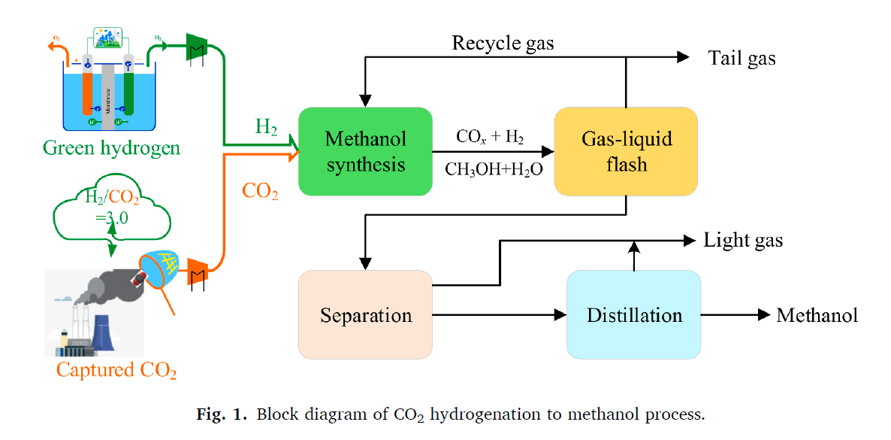
Process description

Slide 6
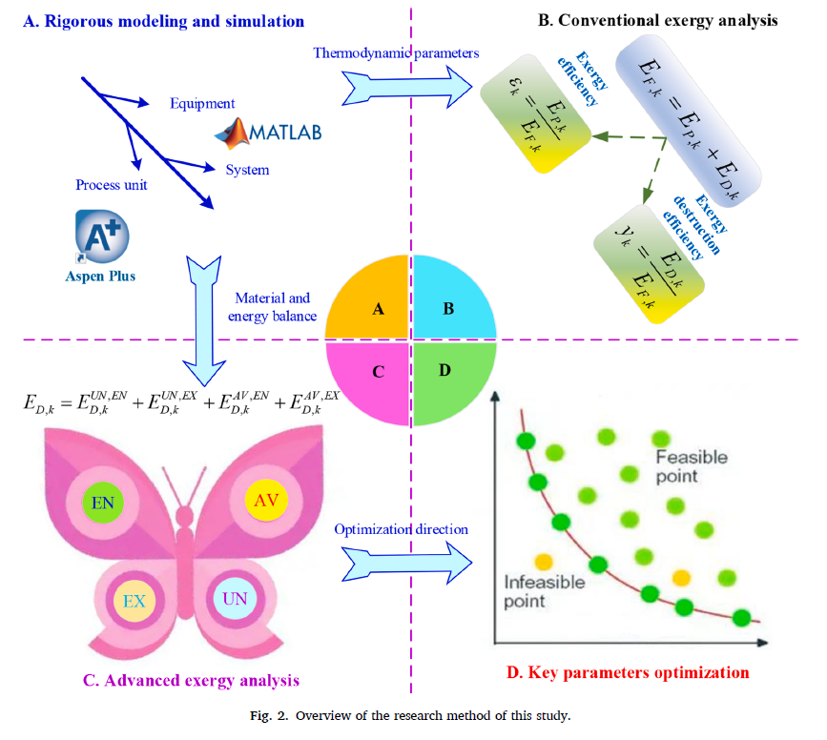
Methodology

Slide 7
Methodology
The workflow for advanced exergy analysis of the CTM (CO2 to methanol) process involves several key steps:
1. Rigorous Modeling and Simulation: - Build models for equipment, process units, and the entire CTM system. - Calculate material and energy balances. | 2. Conventional Exergy Analysis: - Establish the exergy balance for components and the whole system. - Determine exergy efficiency and destruction of the CTM process. | 3. Advanced Exergy Analysis: - Identify essential causes and real improvement potential of exergy destruction. - Split into endogenous (EN), exogenous (EX), unavoidable (UN), and avoidable (AV) parts. | 4. Key Parameters Optimization: - Investigate the effect of key parameters on avoidable exergy destruction. - Provide theoretical basis and technical support for subsequent system improvement. | 5. Development of Improvement Strategies: - Implement effective measures to reduce endogenous and exogenous avoidable exergy destruction based on the analysis results from the previous steps.

Slide 8
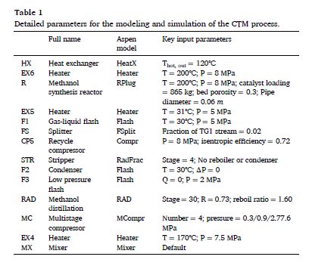
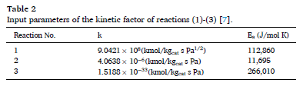
Table of Calculations

Slide 9
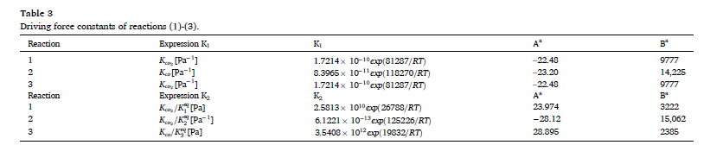
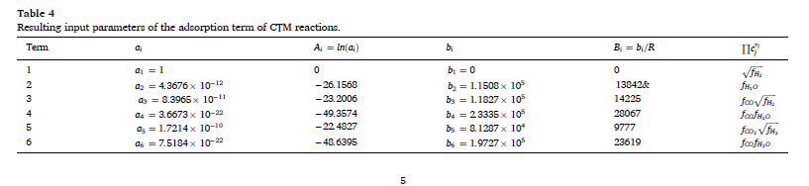
Table of Calculations

Slide 10
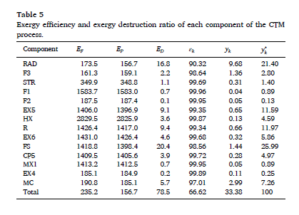
Table of Calculations

Slide 11
It's time to reveal
the results!

Slide 12
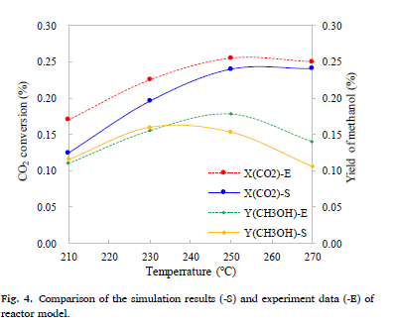
Results and discussion
Simulation results and validation:
Rigorous models of the carbon-to-methanol (CTM) process were employed.
Material and energy balance results are provided in Tables 2 and 3 in the Supporting Information.
The process involves converting 900 kmol/h of CO2 and 2700 kmol/h of H2 into methanol.
Methanol production reaches 787.64 kmol/h with a molar fraction exceeding 99.99%.
Emphasis is placed on the significance of the methanol synthesis reactor.
Simulation results of the reactor are compared with experimental data.
Consistency is observed in the change trend of temperature on CO2 conversion and methanol yield.
Operational parameters are aligned with a previous study for comparison.
The established models and simulations are considered suitable for subsequent system analysis and optimization.

Slide 13
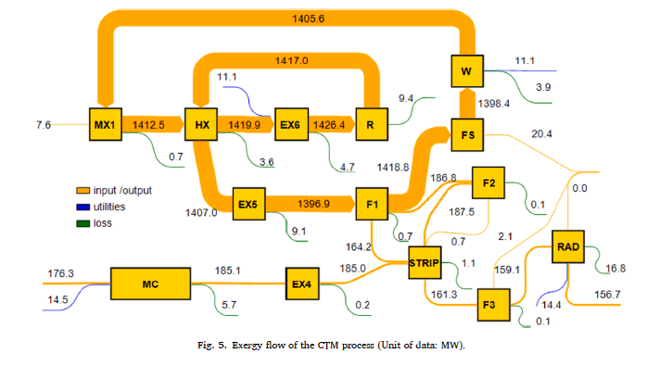
Results and discussion
Implications of the conventional exergy analysis:
The exergy flow diagram of the Carbon-to-Methanol (CTM) process is determined based on material and energy balance results (Fig. 5).
The total input exergy of the CTM process is 235.2 MW, comprising raw material (183.9 MW), heat (25.7 MW), and electricity (25.6 MW).
The input exergy of the CO2 stream is only 7.6 MW due to the small unit chemical exergy of CO2 compared to methanol, CO, and hydrogen.
Unreacted gas (1405.6 MW) is recycled due to the low conversion ratio of CO2 hydrogenation, mixed with fresh CO2, and fed into the reactor.
Crude methanol (164.2 MW) is separated and processed, resulting in 156.7 MW high-purity methanol.
The total exergy efficiency of the CTM process is approximately 66.62%, as indicated in Table 5.
Table 5 shows that the exergy efficiency of all components in the CTM process is higher than 90%, based on the "Fuel-Product" concept.

Slide 14
Results and discussion
Implications of the advanced exergy analysis:
Endogenous and exogenous exergy destruction
Unavoidable and avoidable exergy destruction
Combination of splitting the exergy destruction

Slide 15
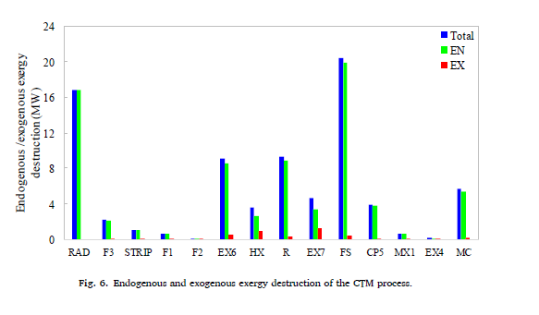
Results and discussion
Implications of the advanced exergy analysis:
Endogenous and exogenous exergy destruction:
The paragraph addresses the division of exergy destruction in a CTM (Coal to Methanol) system into endogenous and exogenous parts.
Results reveal that the majority (94.47%) of exergy destruction is due to endogenous factors.
This underscores the significance of addressing irreversibility within the system's components.
The paragraph suggests a focus on optimizing key components, including the splitter, distillation column, and methanol synthesis reactor.
The goal is to enhance the overall thermodynamic performance of the CTM process through targeted optimization of these components.

Slide 16
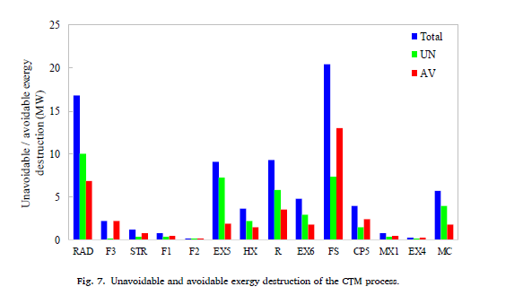
Results and discussion
Implications of the advanced exergy analysis:
2. Unavoidable and avoidable exergy destruction:
Approximately 46.55% of exergy destruction in the CTM (Coal to Methanol) process is revealed to be avoidable.
This represents a significant potential for improvement in exergy destruction reduction.
The remaining 53.45% is constrained by current technical or economic limitations.
The splitter, distillation column, and methanol synthesis reactor are identified as components with the highest avoidable exergy destruction.
This points to a need for focused efforts to enhance the efficiency of these components.

Slide 17
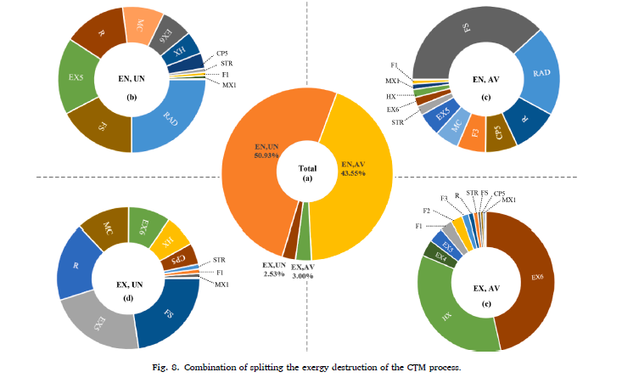
Results and discussion
Implications of the advanced exergy analysis:
3. Combination of splitting the exergy destruction:
Unavoidable endogenous exergy destruction in the CTM (Coal to Methanol) process constitutes the largest portion (50.93%) of total exergy destruction.
This is primarily attributed to the distillation column, splitter, and heat recovery cooler.
These components, constrained by irreversibility in chemical reactions or heat exchange temperature differences, are not recommended for reduction due to current technological and economic feasibility.
Avoidable endogenous exergy destruction comprises 43.55% of total exergy destruction.
It is mainly associated with the splitter, distillation column, and methanol synthesis reactor.

Slide 18
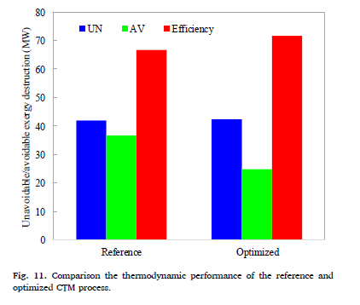
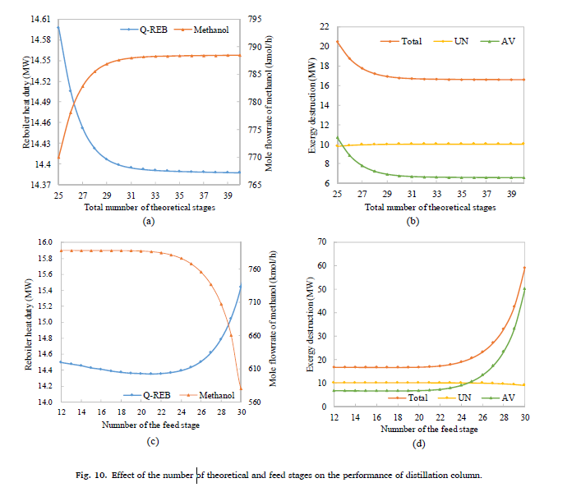
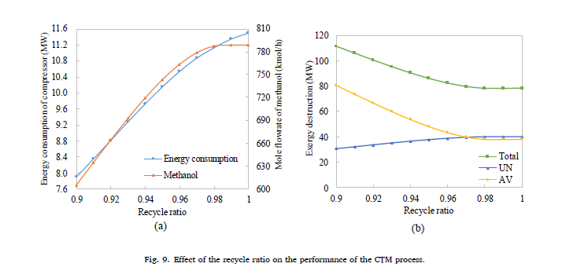
Results and discussion
Key parameters optimization and improvement strategies development:
Reduction of avoidable exergy destruction of the splitter
Reduction of avoidable exergy destruction of the distillation column
Comparison of the optimized and reference CTM processes

Slide 19
CONCLUSION & LIMITATIONS
The study employed advanced exergy analysis to evaluate the CTM process, revealing that endogenous exergy destruction contributes significantly (94.47%) to total exergy destruction, indicating irreversibility within components as a major factor. The research identified a 46.55% potential for real improvement in reducing exergy destruction, with technical or economic constraints limiting 53.45%. Recommendations to reduce avoidable exergy destruction in specific components led to optimized results, reducing total exergy destruction and increasing exergy efficiency. The study also highlighted potential economic implications and suggested future advanced exergoeconomic analysis to address these considerations.

Slide 20
A WARM
THANK YOU
TO ALL OF YOU!

